Slide 1


Getting Started with Sora
Add your school logo here!
© Copyright 2024, OverDrive, Inc.
Notes:
Educators – click to delete the temporary logo box and then click Insert > Pictures on the top PowerPoint toolbar and add your school logo.
Alternately, use the hidden slide (next) if you prefer it. Simply select the slide in the left-hand pane and right-click and choose Hide Slide to “un-hide” it.

Slide 2
Add your school logo here!
Getting Started with Sora
© Copyright 2024, OverDrive, Inc.

Slide 3




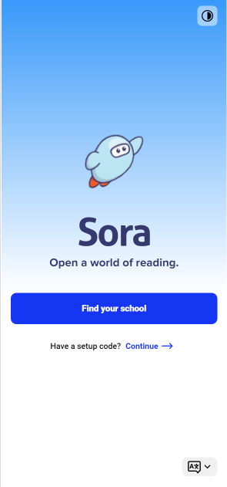

What is Sora?
Sora is an
award-winning
digital reading app
for K-12 schools
soraapp.com
or download the app
© Copyright 2024, OverDrive, Inc.

Slide 4

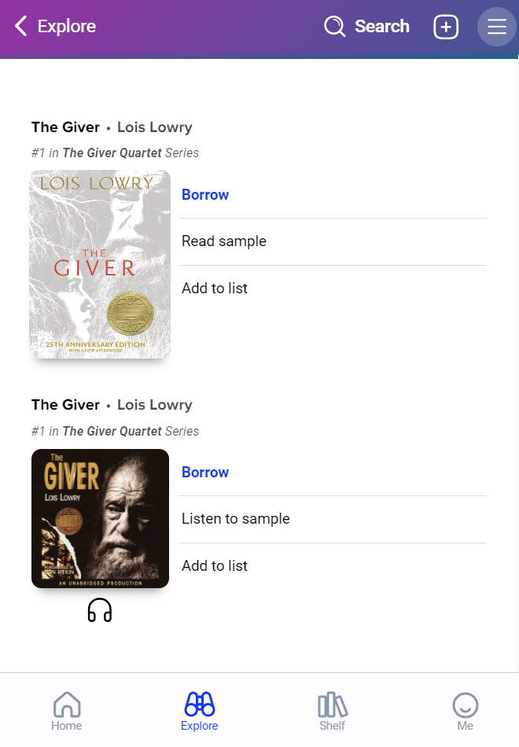
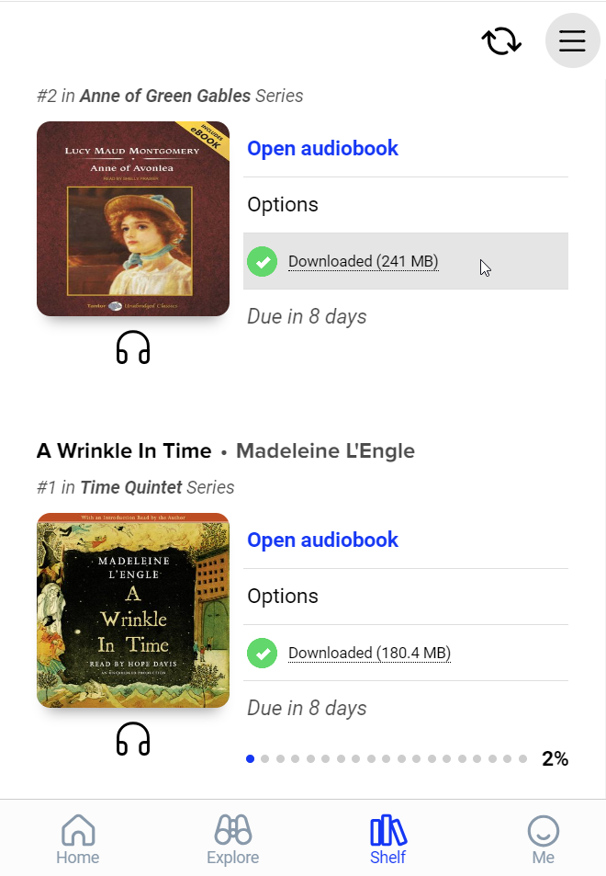
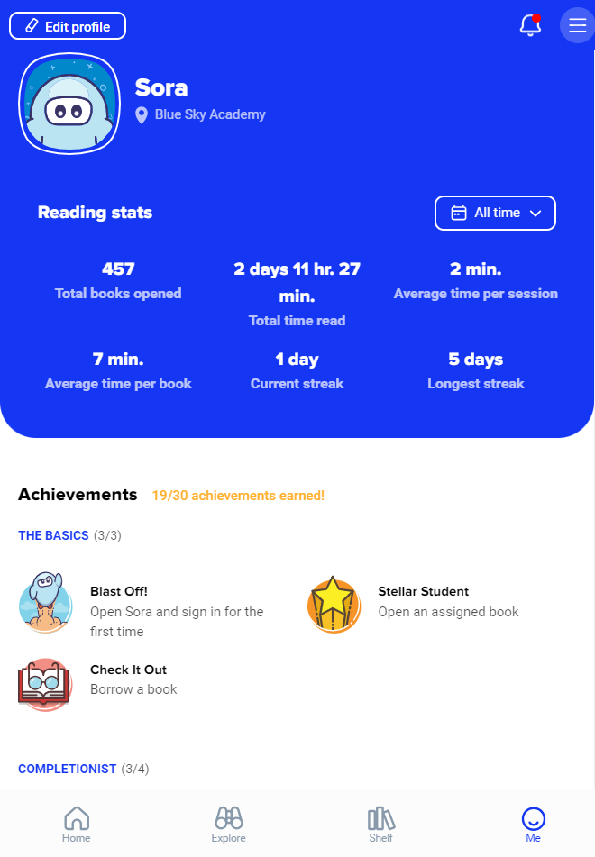
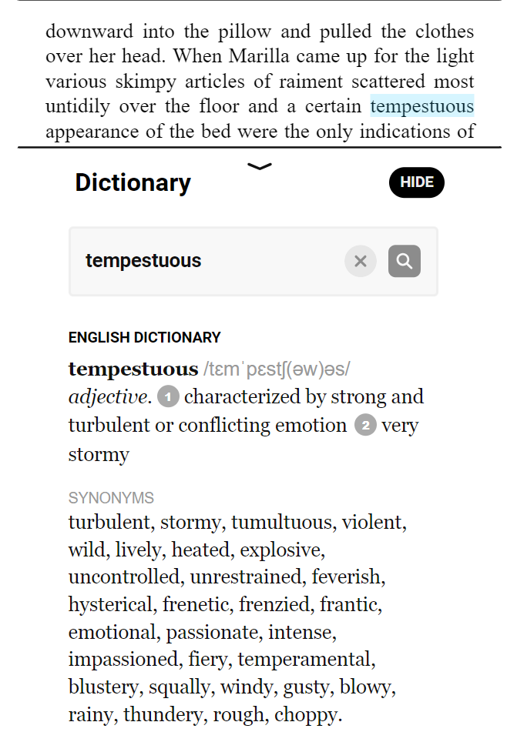
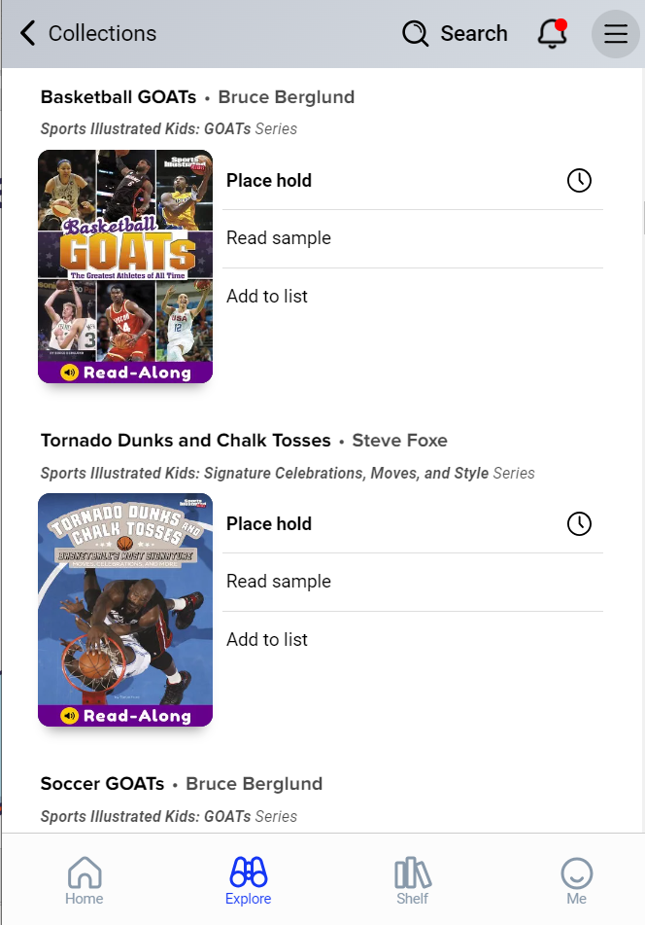
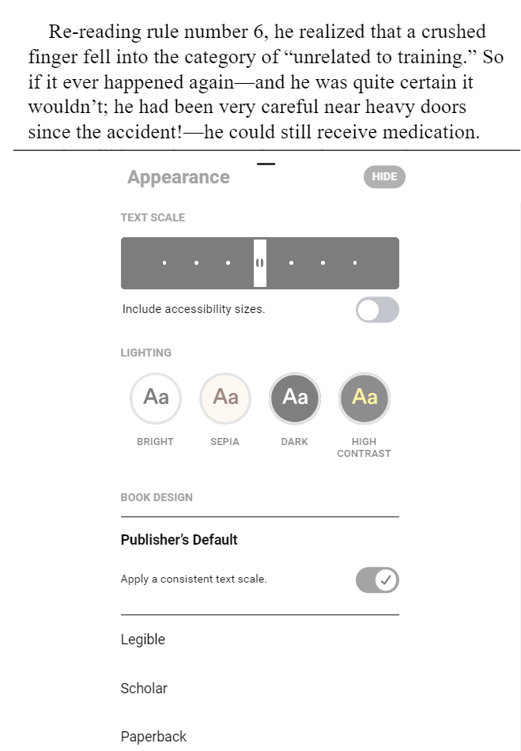
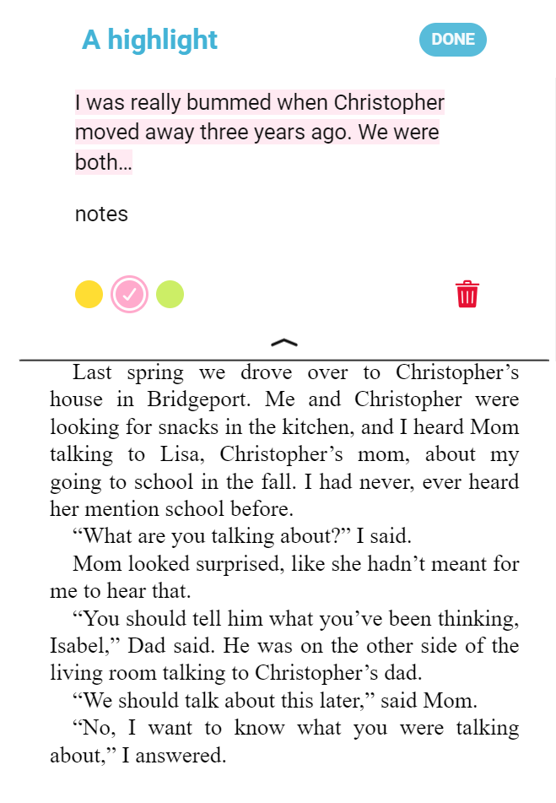
What can students do in Sora?
Read ebooks and listen to audiobooks
Adjust reading or listening settings
Read or listen offline
Define new or unfamiliar words
Add and export bookmarks, highlights, and notes
Place books on hold
View reading stats and earn achievements
Students & staff have access to
all the same great features in Sora!
Notes:
Educators – each bullet point is animated to align with an image of the feature. Just click to advance!

Slide 5
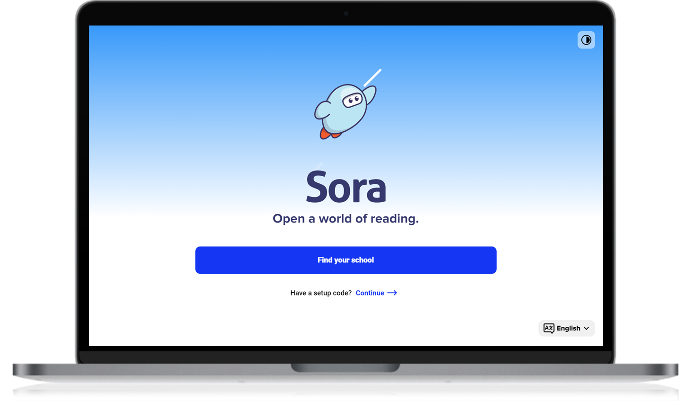
Help students sign in
Download and open the app
or go to soraapp.com.
© Copyright 2024, OverDrive, Inc.
Notes:
Educators – In slideshow mode, the video of searching for the app will play automatically.
Staff will follow the same process to sign in.

Slide 6
Help students sign in
Download and open the app
or go to soraapp.com.
Search for your school OR use a setup code to be taken to your sign in page.
If you have a direct link to your school’s Sora sign in page, students won’t need to search or use a setup code.
© Copyright 2024, OverDrive, Inc.
Notes:
Educators – The animation will play automatically.

Slide 7
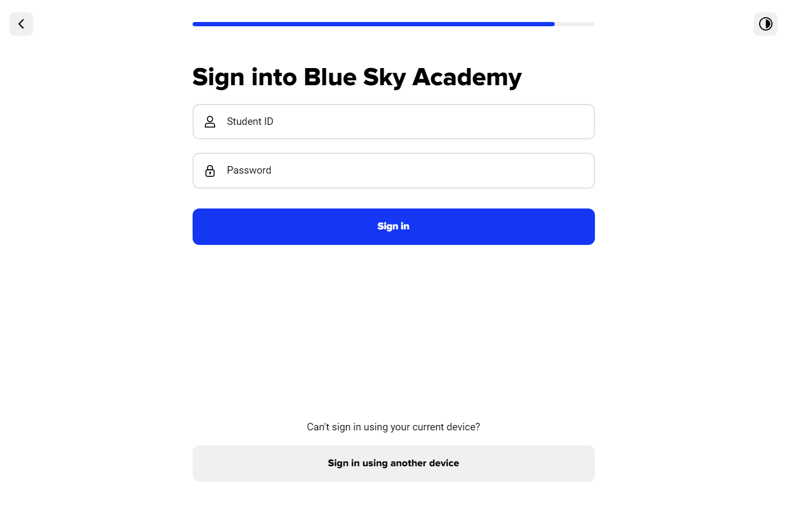
Help students sign in
Download and open the app
or go to soraapp.com.
Search for your school OR use a setup code to be taken to your sign in page.
Log in with your school credentials.
© Copyright 2024, OverDrive, Inc.

Slide 8
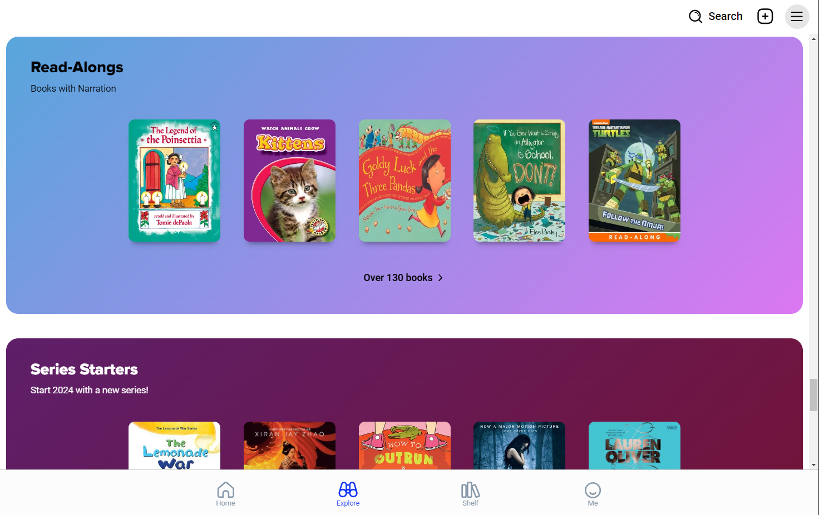
Help students sign in
Download and open the app
or go to soraapp.com.
Search for your school OR use a setup code to be taken to your sign in page.
Log in with your school credentials.
Find a book, borrow, and begin reading or listening!
© Copyright 2024, OverDrive, Inc.
Notes:
Educators – The animation will play automatically.
Feel free to use this as an entry point for staff or as a recap – just drag and drop slides in any order you like (from the left-hand navigation pane).

Slide 9
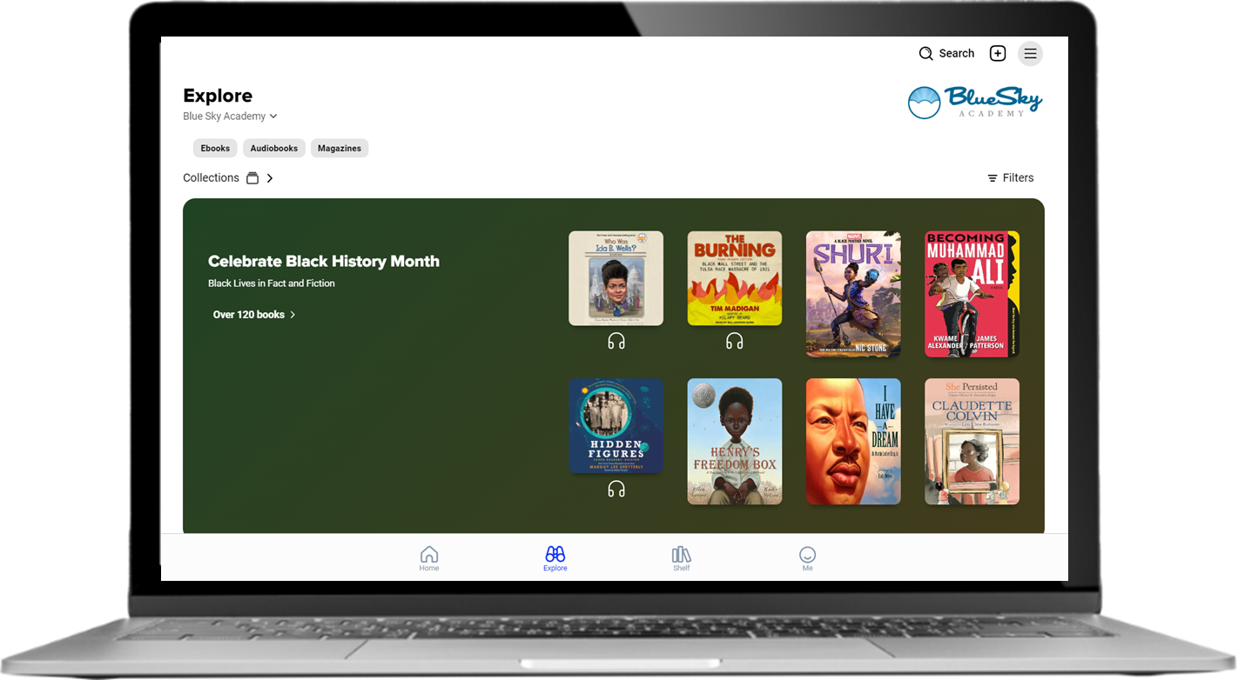
Live demonstration
© Copyright 2024, OverDrive, Inc.
Notes:
Educators – sign into Sora in your web browser. Share your screen to walk through a demonstration of Sora features.

Slide 10
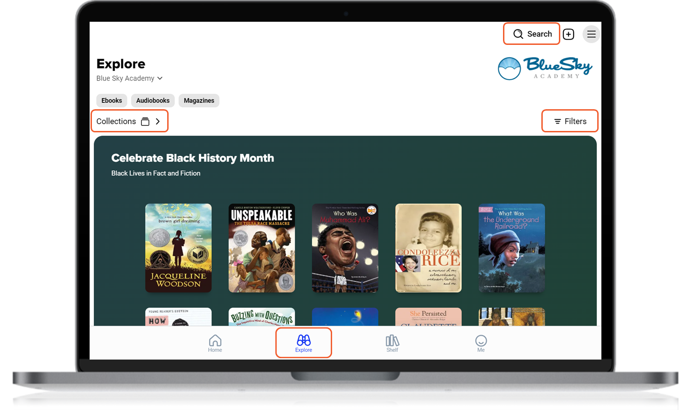
Find a title to read
Find digital titles on the
Explore tab.
Browse collections or search.
Use filters to narrow your results.
Borrow to begin reading.
Place a hold if your title is not available to borrow.
© Copyright 2024, OverDrive, Inc.
Notes:
Educators - bullets will animate in automatically.

Slide 11
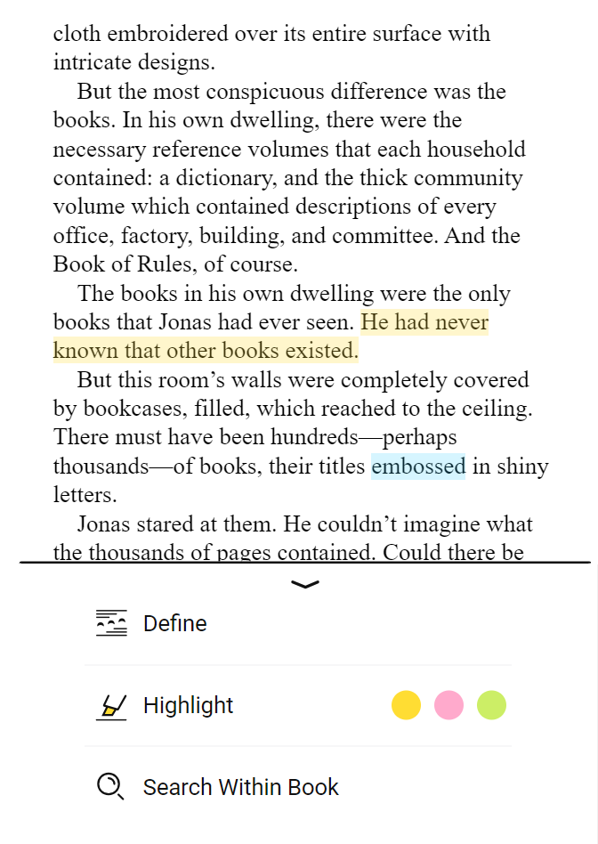
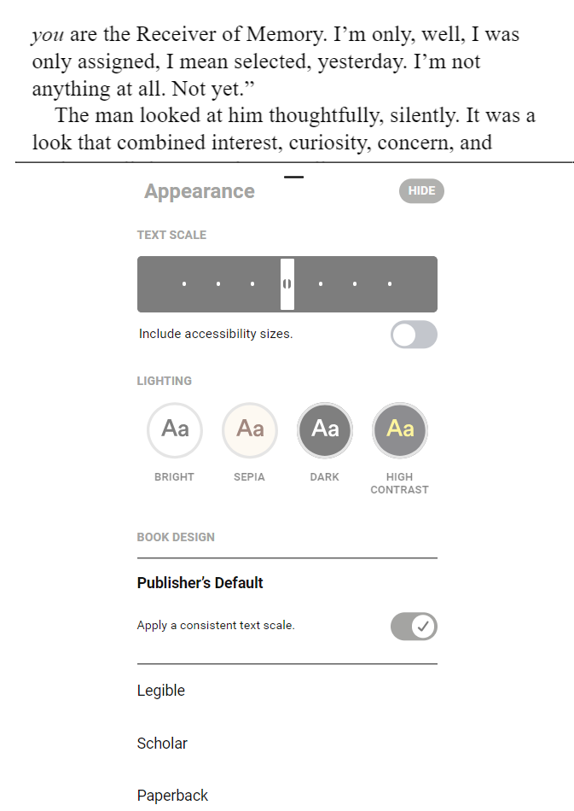
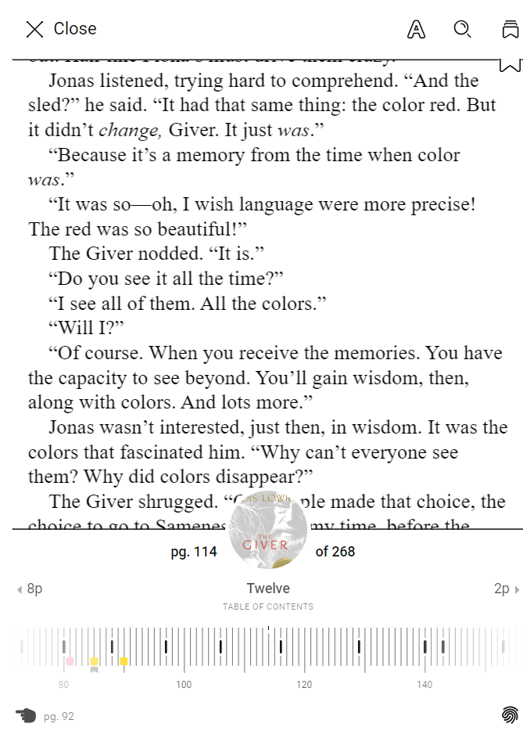
Enjoy ebooks
Interact with the text using definitions, highlights, and notes.
Adjust your reading settings, like text size, lighting, and book design (font).
Navigate by turning pages, using the table of contents or progress bar, or searching.
© Copyright 2024, OverDrive, Inc.
Notes:
Educators – each bullet point is animated to align with an image of the feature. Just click to advance!

Slide 12
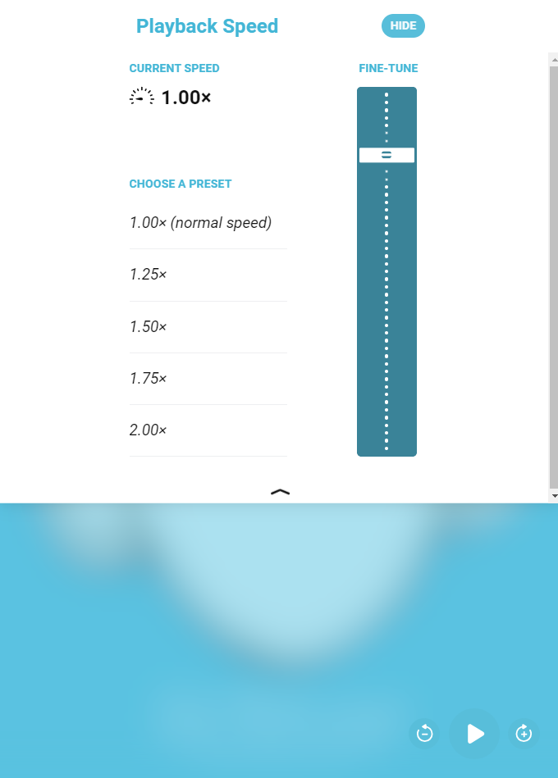
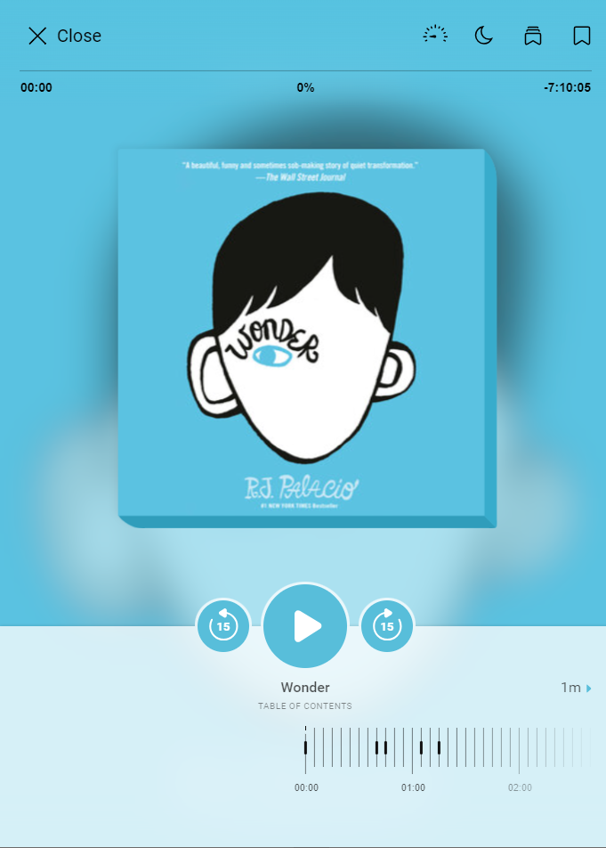
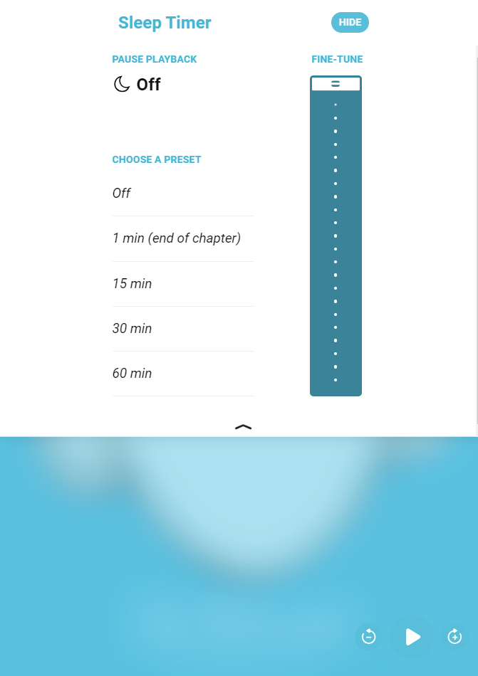
Enjoy audiobooks
Play/pause audio.
Jump ahead or back in 15 second increments.
Adjust the playback speed.
Set a sleep timer.
© Copyright 2024, OverDrive, Inc.
Notes:
Educators – each bullet point is animated to align with an image of the feature. Just click to advance!

Slide 13
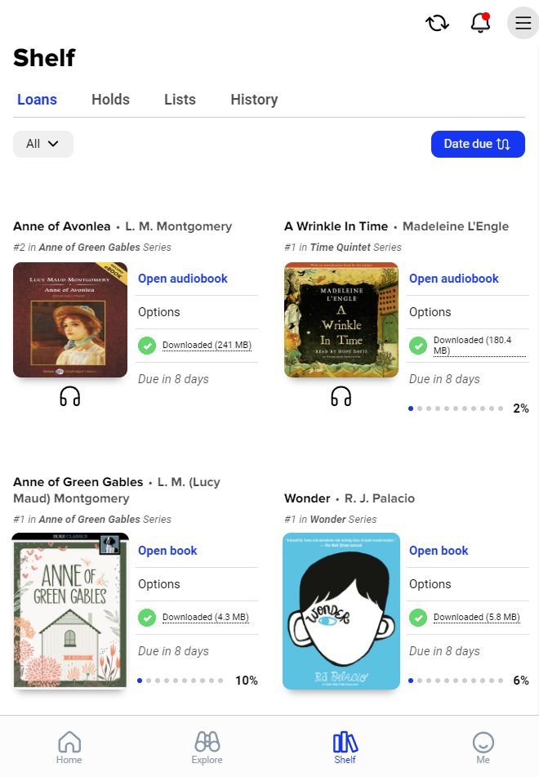
Loans & holds
Keep track of loans & holds on the Shelf tab.
Open your borrowed books at any time.
Feel confident when your loans return automatically on the due date in Sora.
Explore options to early return or renew (if possible).
Enjoy Downloaded titles offline.
Get notified when a title you’ve placed
on hold is available to borrow.
© Copyright 2024, OverDrive, Inc.
Notes:
Educators - bullets will animate in automatically.

Slide 14
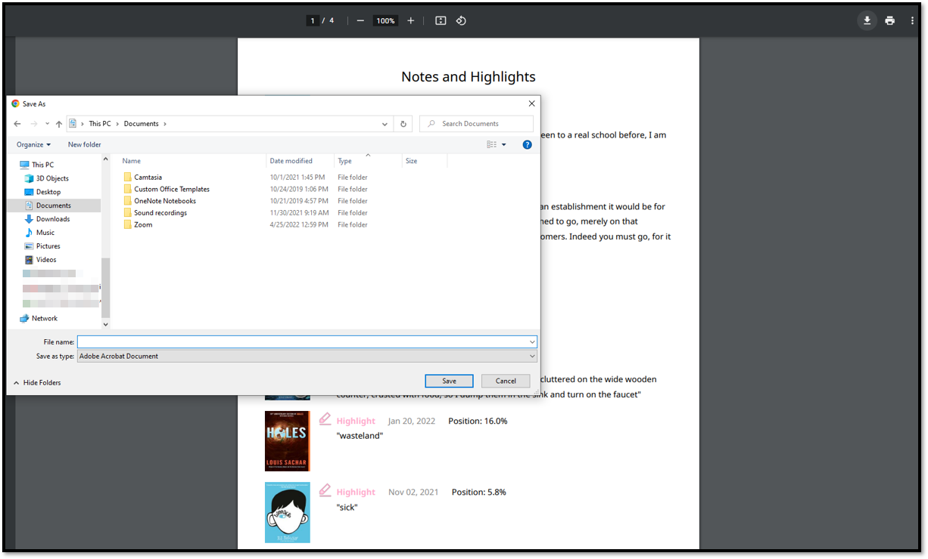
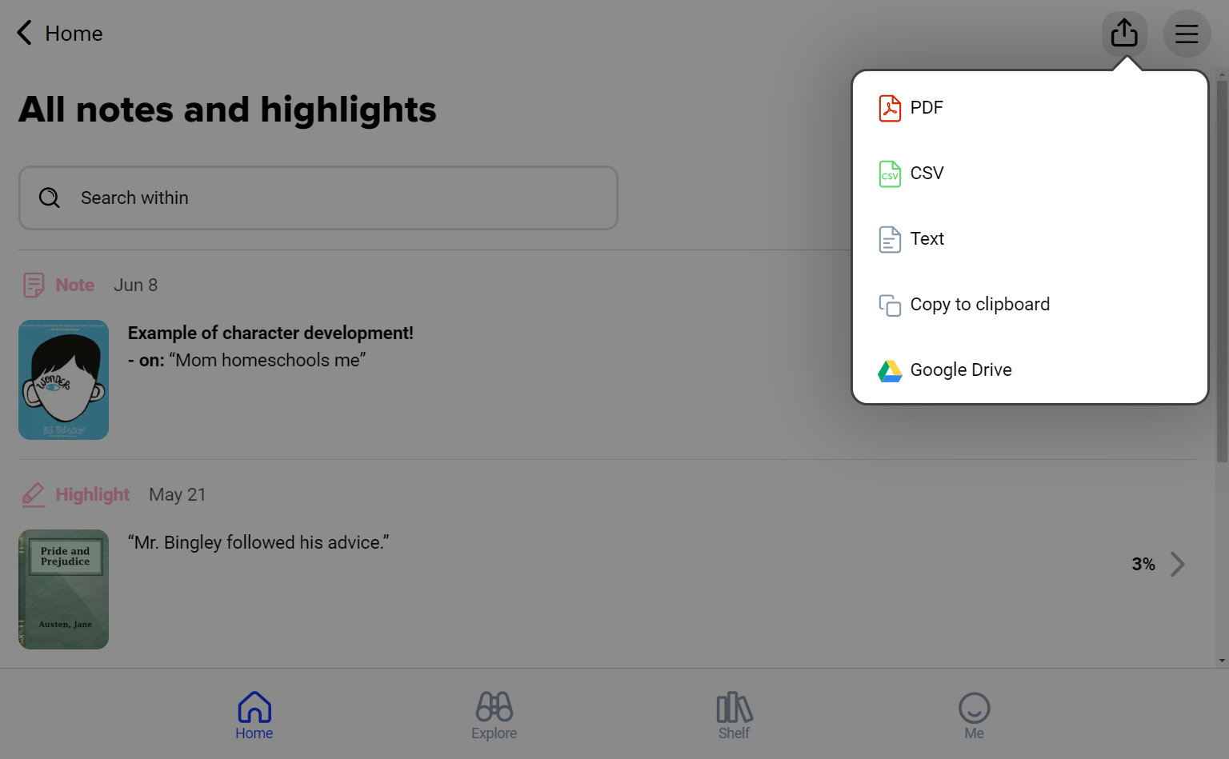

Exportable notes & highlights
Create annotations while reading
View saved annotations even after the book is returned.
Export annotations to use outside of Sora.
Save, print, or share as needed!
© Copyright 2024, OverDrive, Inc.
Notes:
Educators – each bullet point is animated to align with an image of the feature. Just click to advance!

Slide 15
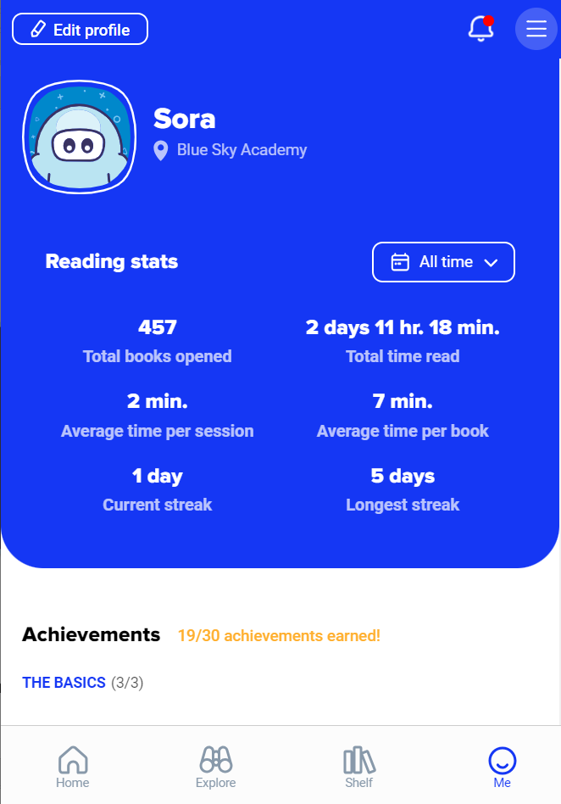
View reading stats
Private to each reader’s account. Users can share with a screenshot
Filter stats to show stats for all time, today, or a custom date range
Available on the Me tab
© Copyright 2024, OverDrive, Inc.
Notes:
Educators - bullets will animate in automatically.

Slide 16
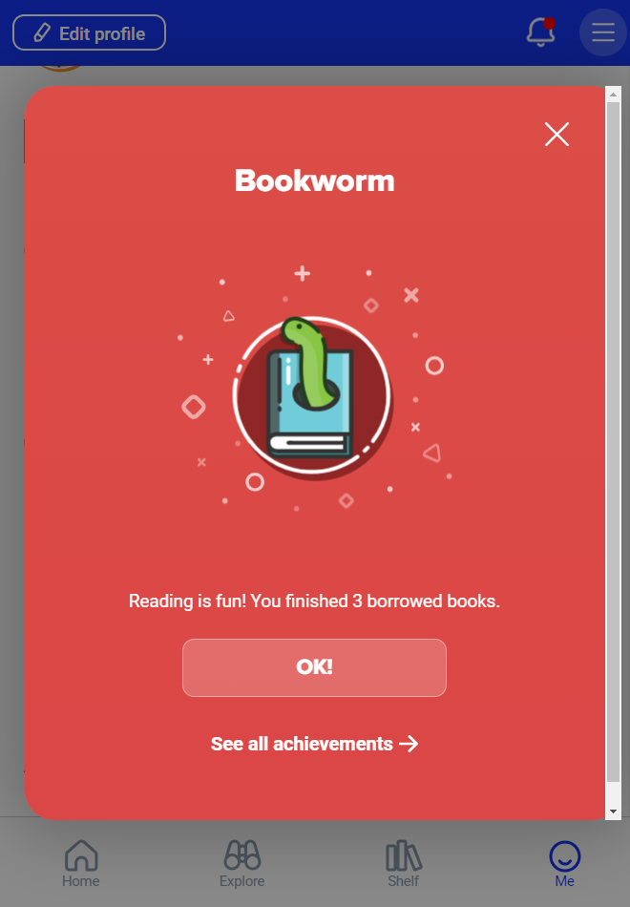
Earn achievement badges
Earn badges for accomplishing a variety of tasks within Sora
View badges on-screen as they are earned; dismiss them easily.
Track earned and unearned badges on the Me tab
© Copyright 2024, OverDrive, Inc.
Notes:
Educators - bullets will animate in automatically.

Slide 17
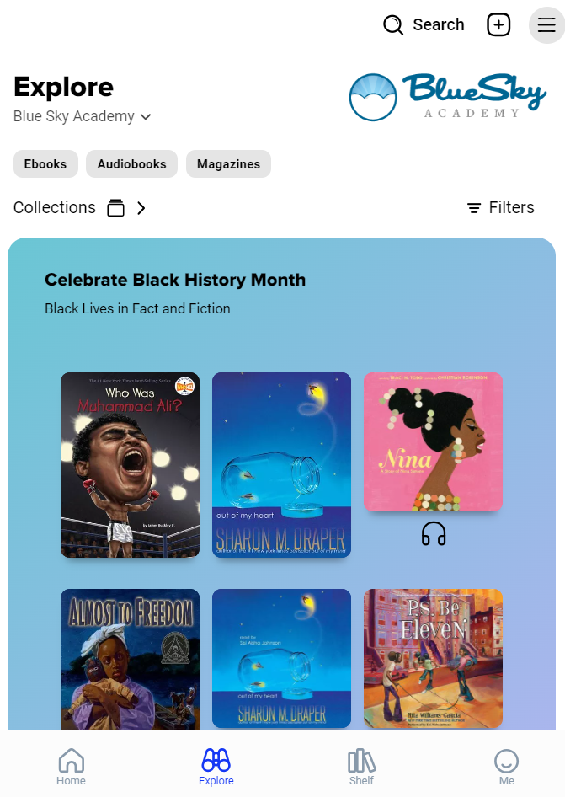

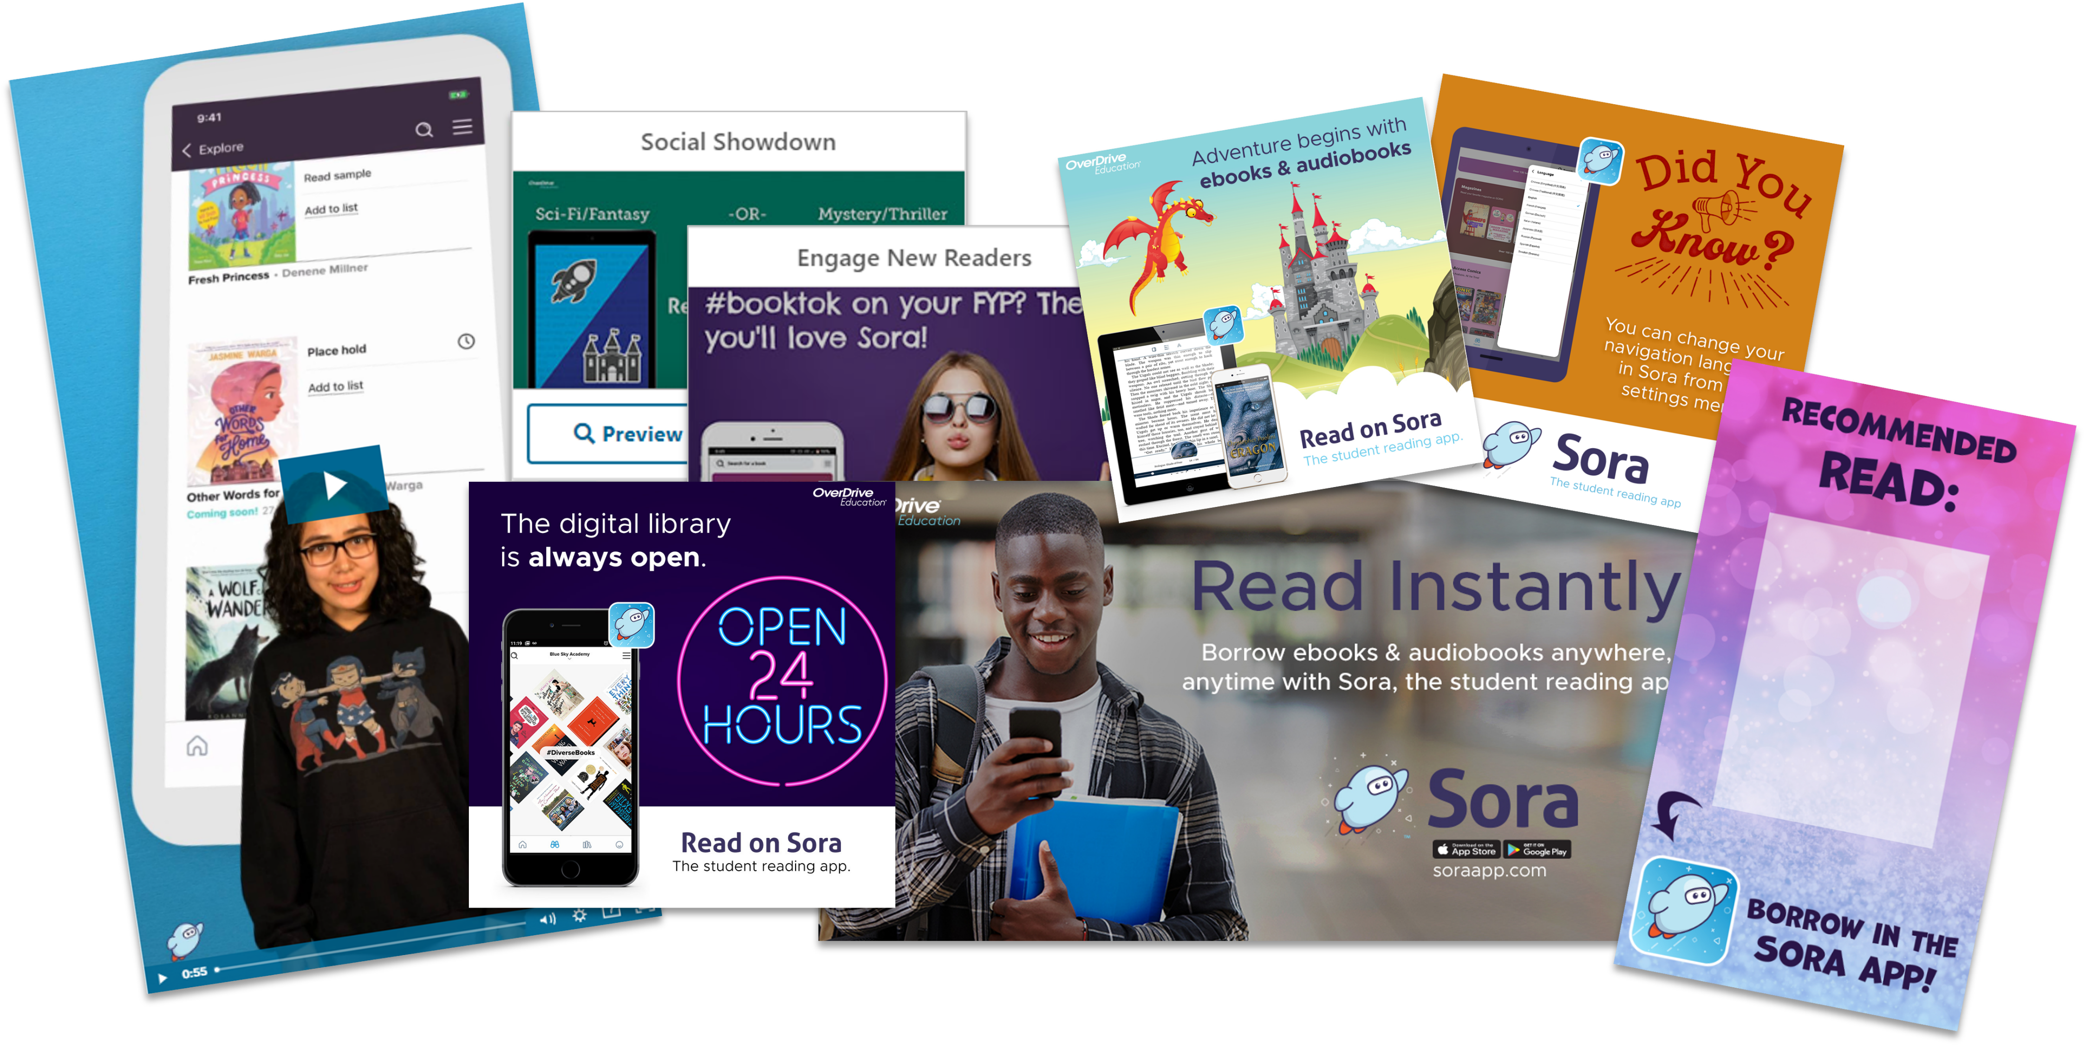
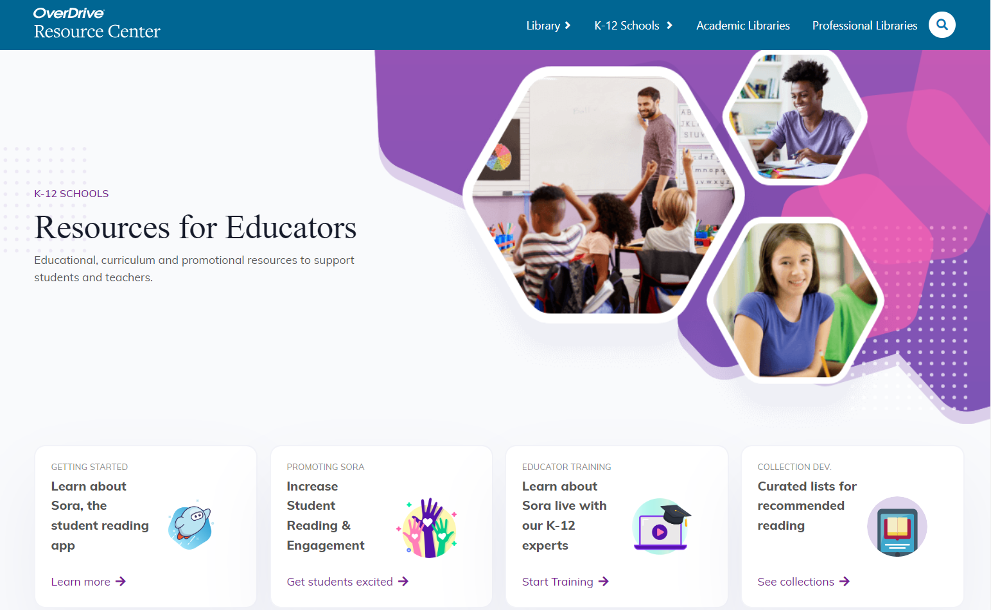
Next steps for success
1
2
3
Download the Sora app
or visit soraapp.com.
Help students explore.
Ensure students can sign in.
Try a guided exploration!
Explore marketing materials
& more on the Resource Center.
© Copyright 2024, OverDrive, Inc.
Notes:
Educators - the three steps will animate in automatically.

Slide 18

Resource Center
Marketing and outreach materials,
classroom activities,
curriculum support,
book recommendation lists,
webinars & how-to videos,
self-paced training,
training kits, &
so much more!
https://resources.overdrive.com/k-12-schools/
© Copyright 2024, OverDrive, Inc.

Slide 19
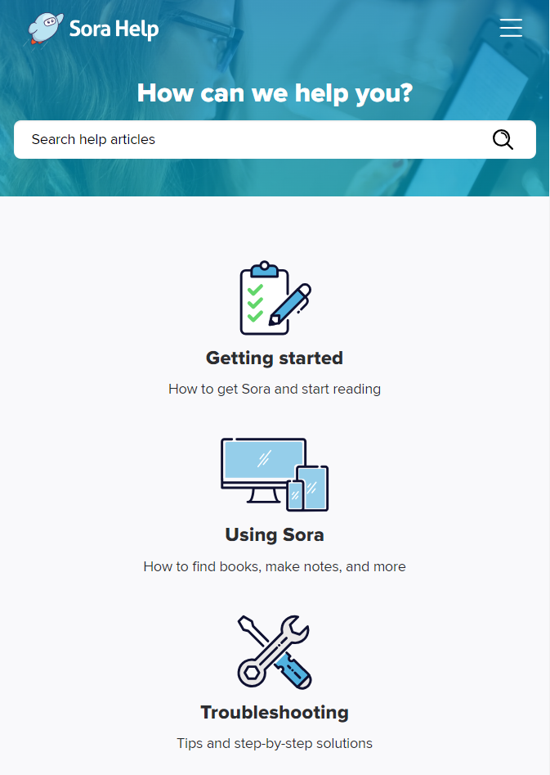
Sora Help
Detailed, step-by-step articles to help you get started, use Sora, and troubleshoot
Access in the browser at help.soraapp.com or open directly from the Main Menu in Sora
Available in 13 languages
© Copyright 2024, OverDrive, Inc.
Notes:
https://resources.overdrive.com/k-12-schools/

Slide 20
Type your title here
Use bullet points or
Change this into a paragraph for your needs
Notes:
Educators – Feel free to use this slide as needed.
You can also delete this slide or unhide it by selecting it in the left-hand pane, right-clicking and choosing, “Hide Slide.”

